Slide 1
Multi-Class Infrastructure damage Classification using Aerial Remote Sensing
Chennakeshava Akhil Pillalamarri
Regis University
MSDS-696 Data Science Practicum-2

Slide 2
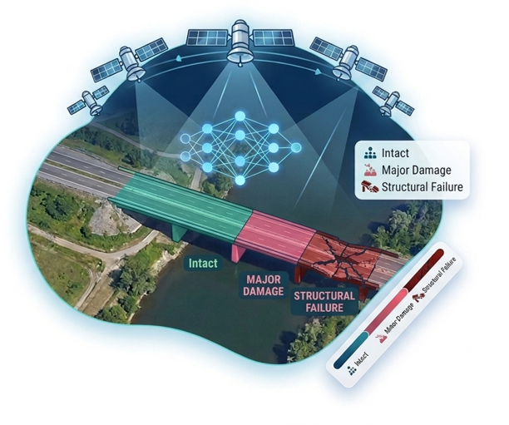
Problem Statement
Manual survey assessing one building at a time, which is slow, expensive, inconsistent
Aim to build a CNN-based system to automatically classify aerial images into 3 distinct damage classes:
Intact
Major Damage
Structural Failure

Slide 3
Dataset Overview
LADI (Low-Altitude Disaster Imagery), publicly available federal disaster imagery dataset in the USA
Collected by Civil Air Patrol using official FEMA Damage assessment criteria, developed by MIT Lincoln Laboratory
Total 9,969 images in the dataset, mapped into 3 damage classes, based on the official FEMA preliminary Damage Assessment scale
Train, Validation and Test split pre-defined by MIT Lincoln Laboratory following the 80/9/11 ratio
Split | Total | Percentage
Train | 8030 | 80%
Validation | 890 | 9%
Test | 1049 | 11%
Total | 9969

Slide 4
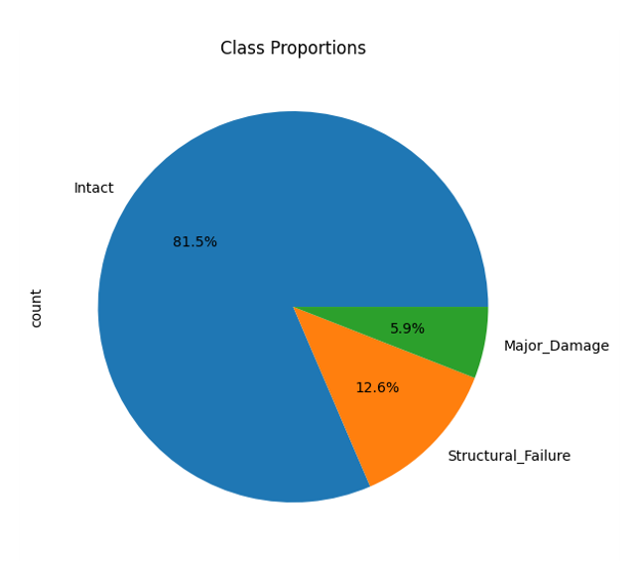
Class Distribution
Class distribution show severe imbalance, dominated by the Intact damage class
Model predicting every image as Intact, achieving 81.5% accuracy is misleading for the imbalanced data
Macro F1 score chosen as the primary evaluation metrics, to treat all three classes with equal importance
Split | Intact | Major Damage | Structural Failure | Total
Train | 6,542 | 476 | 1012 | 8030
Validation | 710 | 65 | 115 | 890
Test | 1,001 | 22 | 26 | 1049

Slide 5
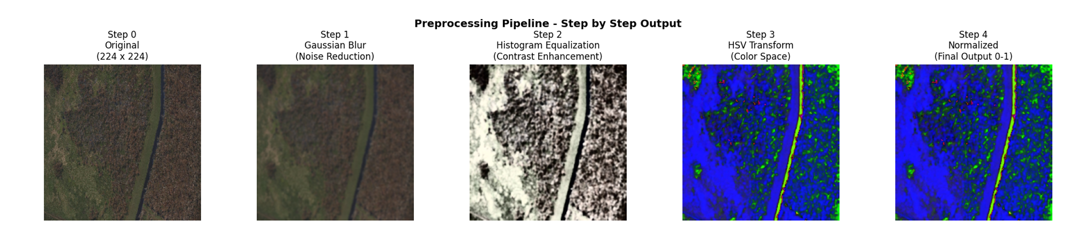
Custom Preprocessing pipeline
All preprocessing functions backed by peer-reviewed research articles in aerial and remote sensing imagery
Every image in the dataset, pushed through this pipeline before model training
Function | Purpose | Reference
Gaussian Blur | Remove Sensor noise | Hanzla et al., Frontiers 2024
Histogram Equalization | Improve image contrast | Hanzla et al., Frontiers 2024
HSV Color Transform | Separate any damage signatures | PMC HSVGLCM UAV study 2024
Resize image | Standardizing the input image | Abdelmonem et al., Scientific Reports 2025

Slide 6
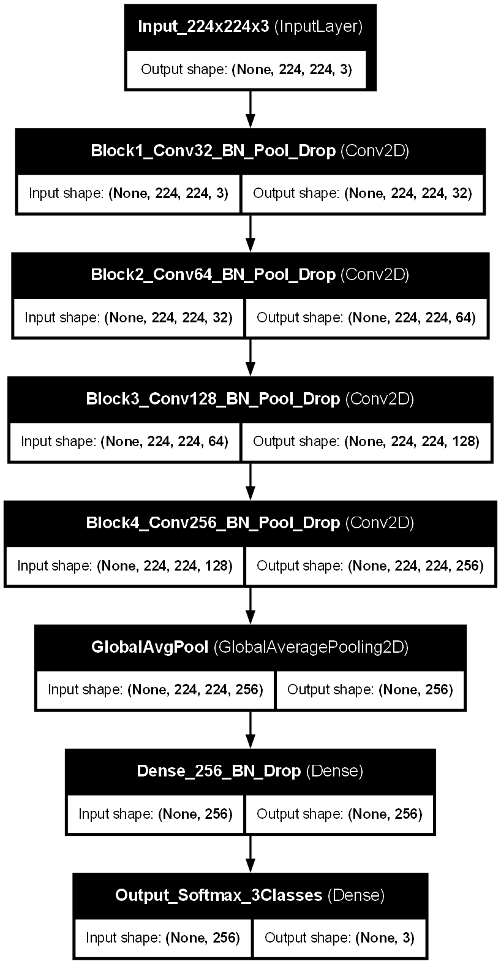
Base Custom CNN Architecture
Built with 4 convolutional blocks with filters 32, 64, 128 and 256, with no pre-trained weights
Each block has Conv2D for feature extraction, Batch Normalization for training stability, MaxPooling to reduce spatial dimensions and DropOut to prevent overfitting.
Hyperparameter | Value
Input Size | 224x224x3
Optimizer | Adam
Learning Rate | 1e-4
Loss Function | Focal Loss = 2.0
Batch Size | 33 (11 per class)
Early Stopping | Patience = 8 – Val Accuracy
LR Reduction | Patience = 4 – Factor=0.5
Dropout Rates | 0.25-0.30-0.40-0.50
Epochs(Max) | 50
Loss Function | Categorical Cross Entropy
Output Activation | Softmax

Slide 7
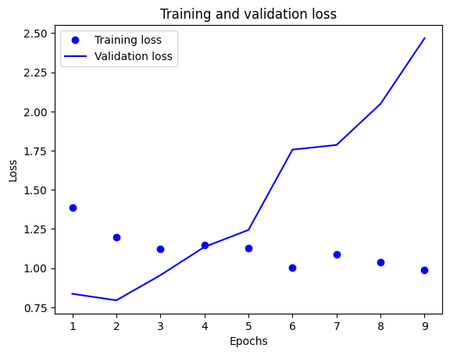
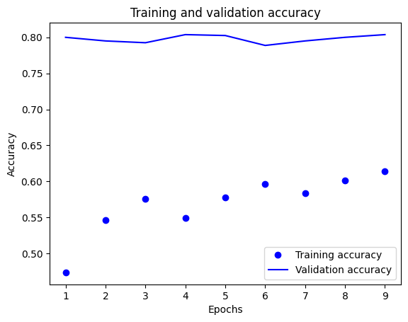
Base CNN Results
Overall Test Accuracy of 100%, where the model predicted everything as Intact due to severe class imbalance
Class | Precision | Recall | F1 Score
Intact | 0.95 | 1.00 | 0.98
Major Damage | 0.00 | 0.00 | 0.00
Structural Failure | 0.00 | 0.00 | 0.00
Macro Average | 0.32 | 0.33 | 0.33
Metric | Value
Test_ACC | 100%
Macro F1 | 0.33
Major_Damage_Detect | 0%
Structure_Failure Detect | 0%

Slide 8
Strategies to address class imbalance
5 out of 7 strategies failed to detect minority classes, breakthorugh when focal loss combined with macro f1 monitoring
Strategy | Purpose | Intact F1 | MD F1 | SF F1 | Macro F1
Baseline | No Imbalance Handling | 0.98 | 0.00 | 0.00 | 0.33
Class Weights Val_Acc | Compute_class_weight balanced | 0.98 | 0.00 | 0.00 | 0.33
Class Weights Val_Loss | Switched to monitor val_loss | 0.93 | 0.00 | 0.00 | 0.31
Focal Loss + Balanced Generator | Gamma = 2.0 + 11 per class per batch | 0.98 | 0.00 | 0.00 | 0.33
Threshold Adjustment | Automatic threshold search | 0.88 | 0.00 | 0.01 | 0.30
Focal Loss + Macro F1 + Balanced Generator | Gamma = 2.0 + val_macro_f1 monitoring | 0.92 | 0.11 | 0.02 | 0.35
Targeted + Validation Augmentation | MD 476 – 9044 (x19), SF 1,012 – 11,132 (x11), resizing to 160x160 | 0.97 | 0.13 | 0.11 | 0.40

Slide 9

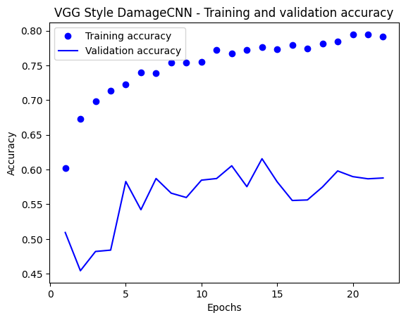
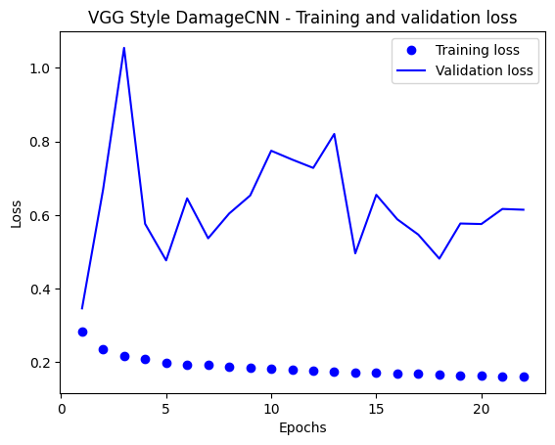
VGG-16
3 and 4 blocks use triple stacked Conv2D layers, giving 12 convolutional layers
Trained on original unaugmented data with same hyper parameters as base CNN, minority class remain undetected even with deeper architecture
Class | Precision | Recall | F1 Score
Intact | 0.95 | 0.99 | 0.97
Major Damage | 0.00 | 0.00 | 0.00
Structural Failure | 0.00 | 0.00 | 0.00
Macro Average | 0.32 | 0.33 | 0.32
Metric | Value
Test_ACC | 94.66%
Macro F1 | 0.33
Major_Damage_Detect | 0%
Structure_Failure Detect | 0%

Slide 10
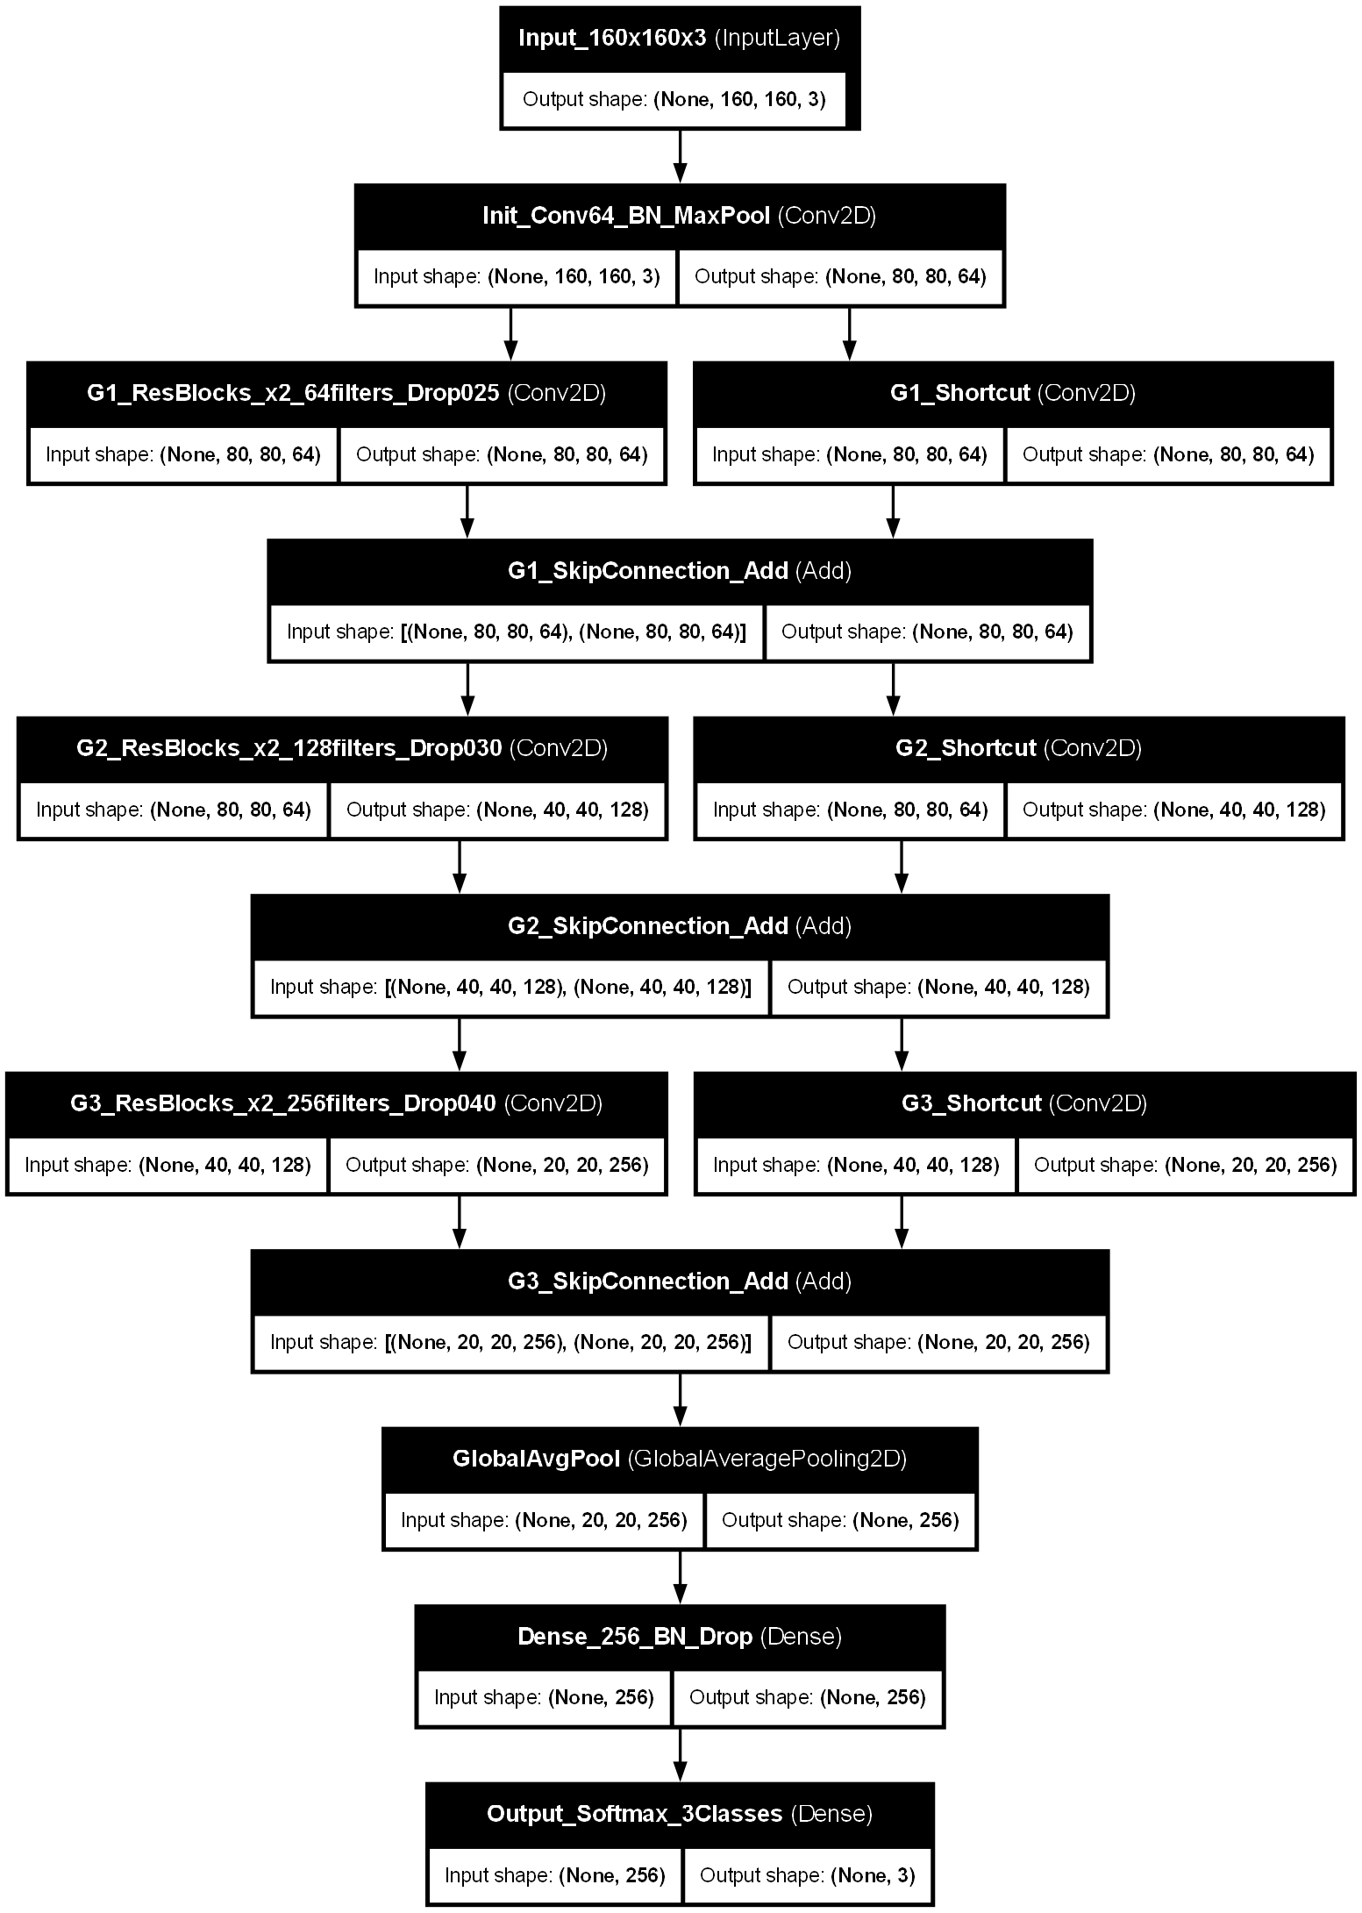
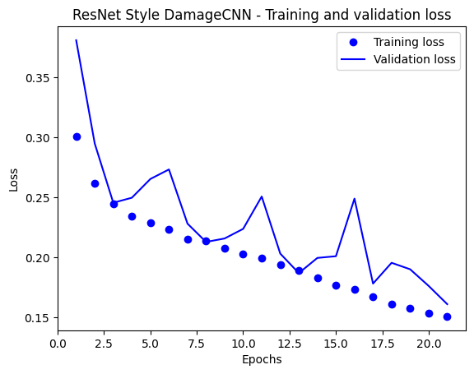
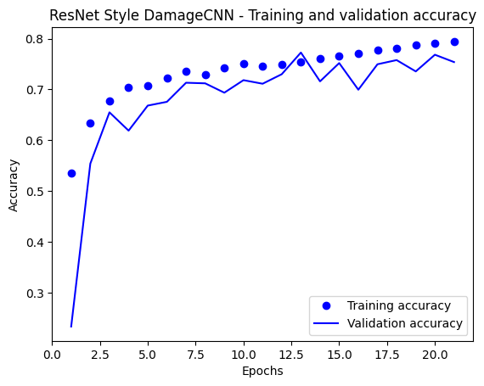
Resnet-18
3 residual blocks, skip connections add block input to output
Trained on augmented dataset at 160x160x3
Hyperparameter | Value
Input Size | 160x160x3
Optimizer | Adam
Learning Rate | 1e-4
Loss Function | Focal Loss = 3.0
Early Stopping | Patience = 8 – Val Macro F1
LR Reduction | Patience = 4 – Factor=0.5
Epochs(Max) | 50
Class | Precision | Recall | F1 Score
Intact | 0.96 | 0.95 | 0.95
Major Damage | 0.00 | 0.00 | 0.00
Structural Failure | 0.06 | 0.12 | 0.08
Macro Average | 0.34 | 0.35 | 0.34
Metric | Value
Test_ACC | 90.56%
Macro F1 | 0.34
Major_Damage_Detect | 0%
Structure_Failure Detect | 69.23%

Slide 11
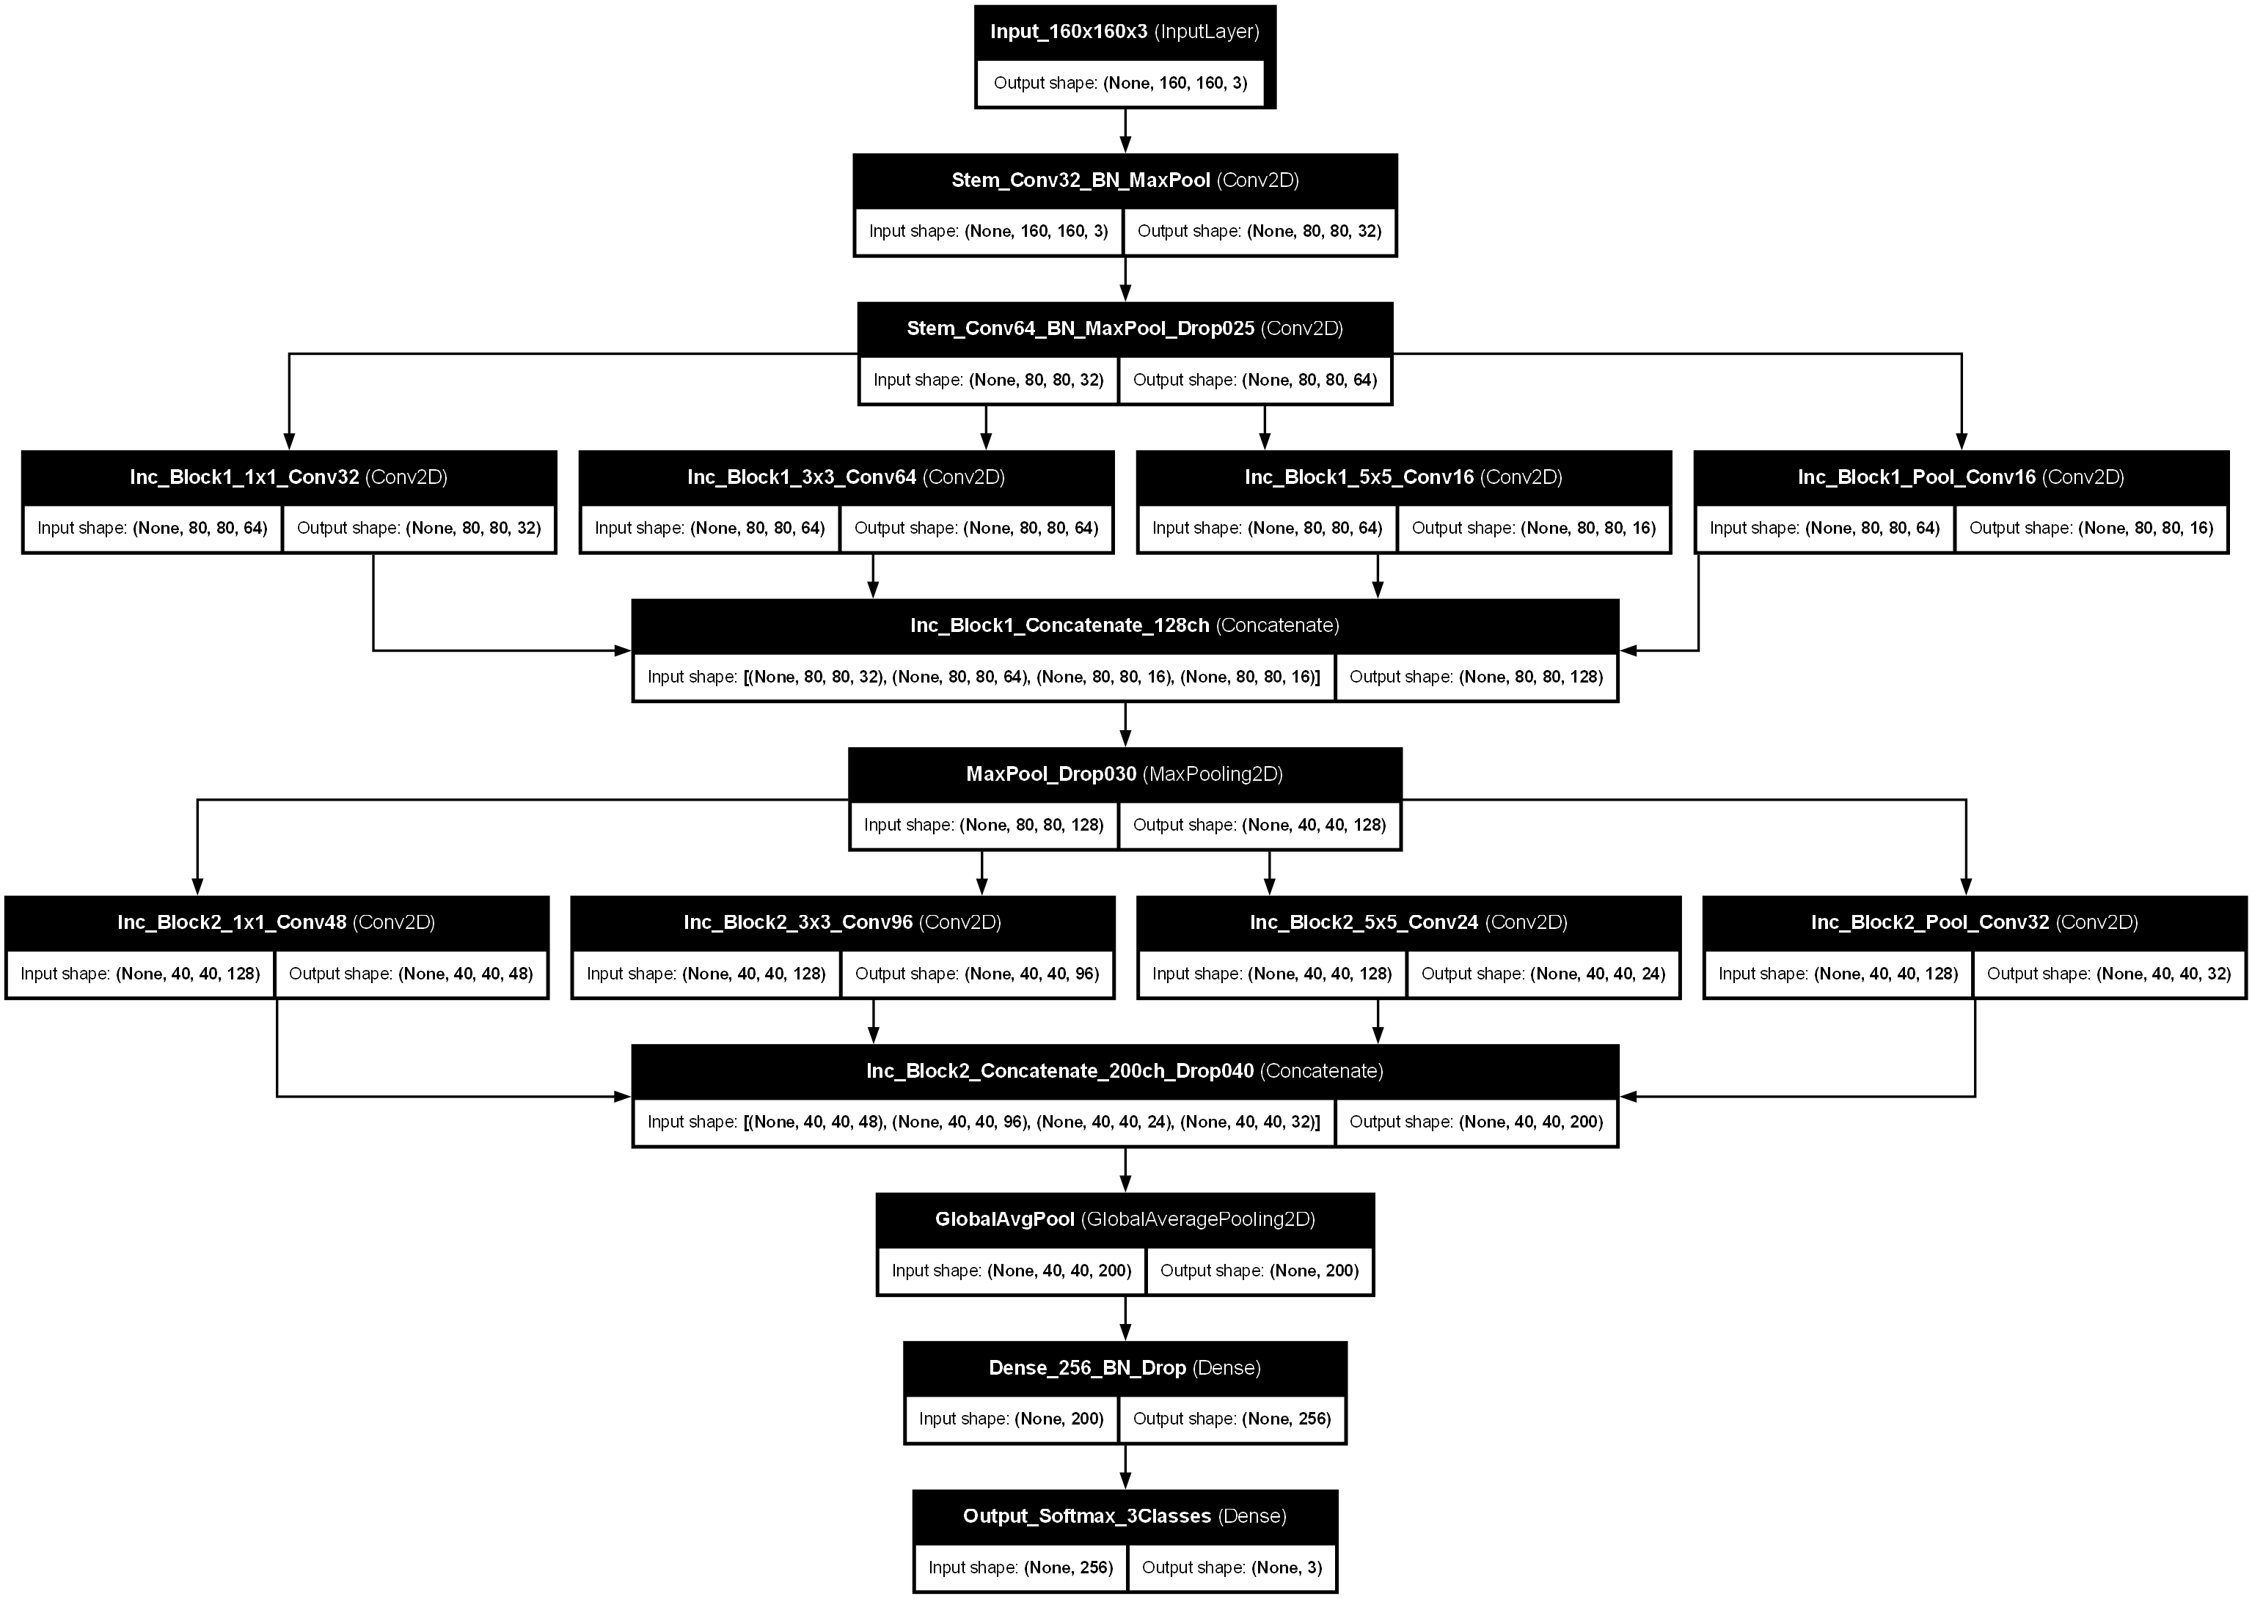
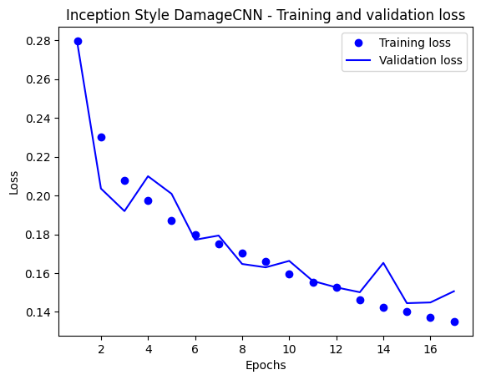
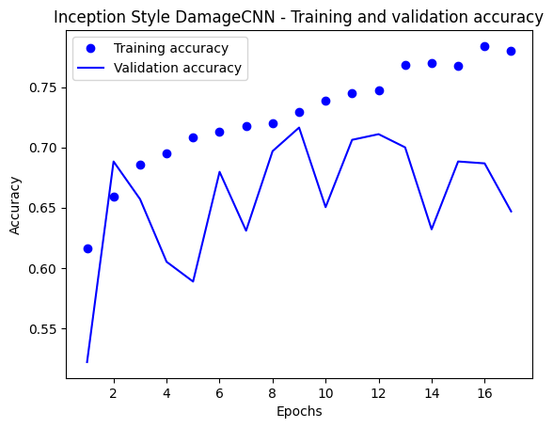
Inception-v1
Parallel 1x1, 3x3, 5x5 convolutions in each block to capture damage features at multiple scales simultaneously
Trained with augmented dataset and same hyperparameters as ResNet
Metric | Value
Test_ACC | 64.73%
Macro F1 | 0.29
Major_Damage_Detect | 0%
Structure_Failure Detect | 92.31%
Class | Precision | Recall | F1 Score
Intact | 0.99 | 0.66 | 0.79
Major Damage | 0.00 | 0.00 | 0.00
Structural Failure | 0.05 | 0.69 | 0.09
Macro Average | 0.34 | 0.45 | 0.29

Slide 12
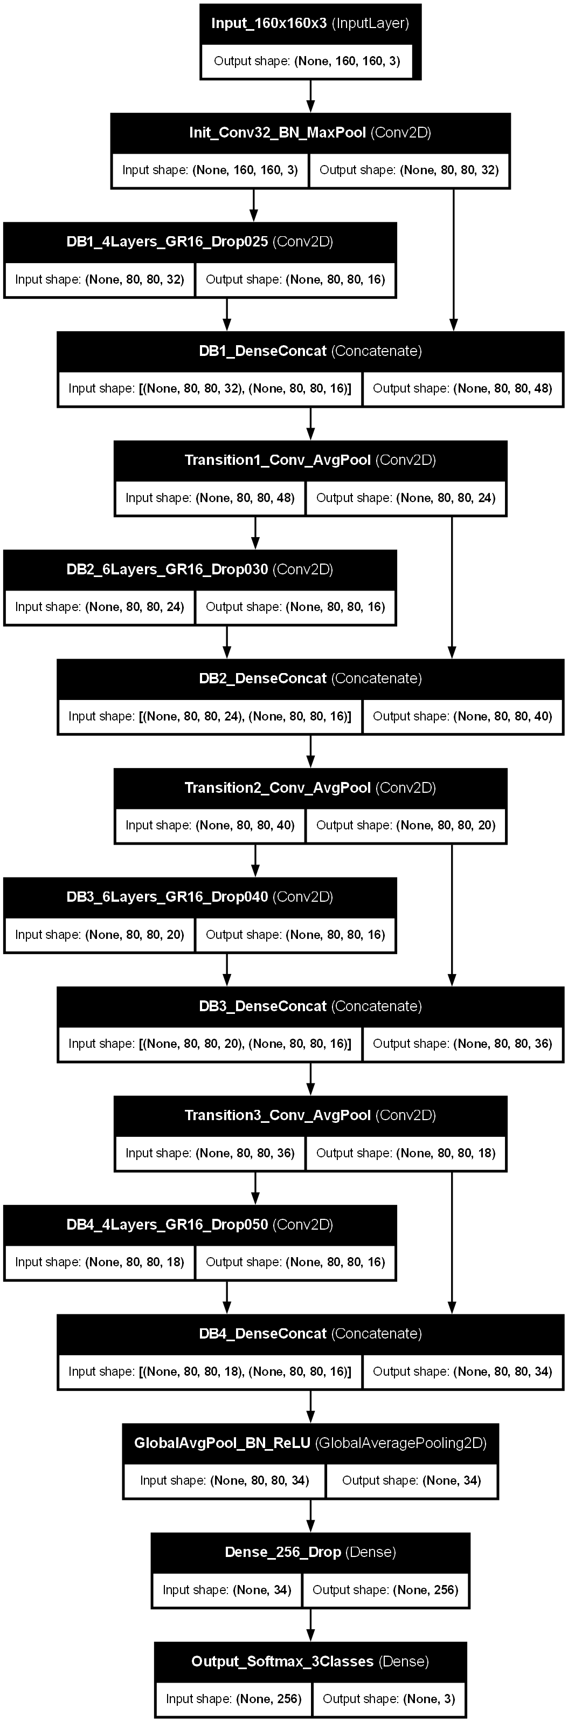
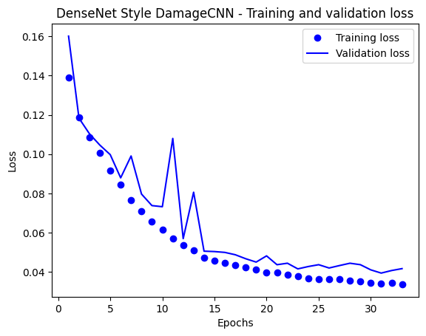
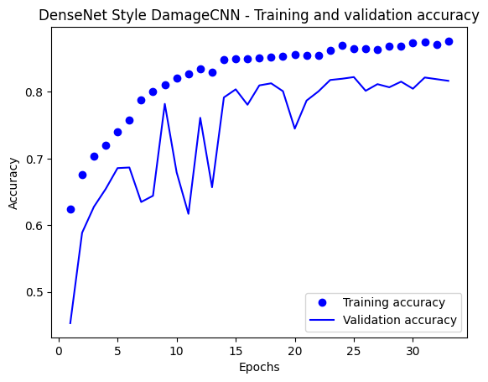
DenseNet-40
Every layer receives feature maps from previous layers , to make sure no feature is lost
Lightest model having only 350,303 parameters, trained on augmented dataset with same parameters as ResNet
Metric | Value
Test_ACC | 94.28%
Macro F1 | 0.3116
Major_Damage_Detect | 0%
Best Val_Macro_F1 | 0.8143
Structure_Failure Detect | 84.62%
Class | Precision | Recall | F1 Score
Intact | 0.95 | 0.99 | 0.97
Major Damage | 0.17 | 0.05 | 0.07
Structural Failure | 0.00 | 0.00 | 0.00
Macro Average | 0.37 | 0.34 | 0.35

Slide 13

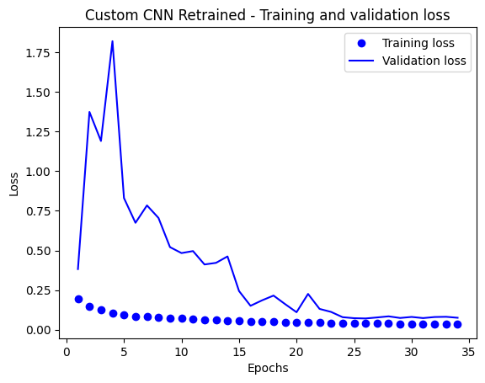
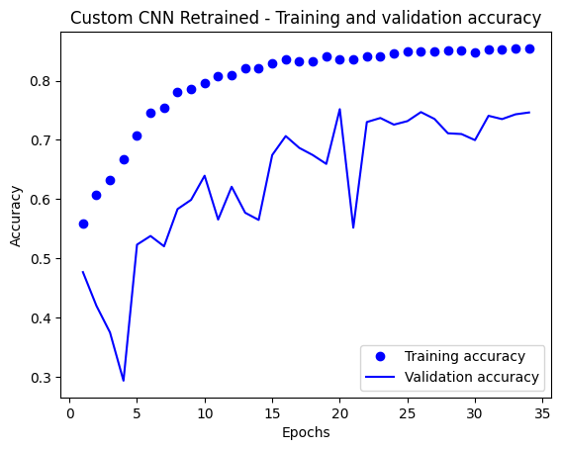
Retrained Base CNN
Same Base CNN architecture, with changing the input from 224x224x3 to 160x160x3, focal loss 2.0 to 3.0
Trained on the augmented dataset, with same parameters as ResNet
Metric | Value
Test_ACC | 85.70%
Macro F1 | 0.2966
Major_Damage_Detect | 32%
Best Val_Macro_F1 | 0.7367
Structure_Failure Detect | 23.08%
Class | Precision | Recall | F1 Score
Intact | 0.97 | 0.89 | 0.93
Major Damage | 0.08 | 0.45 | 0.13
Structural Failure | 0.00 | 0.00 | 0.00
Macro Average | 0.35 | 0.45 | 0.35

Slide 14
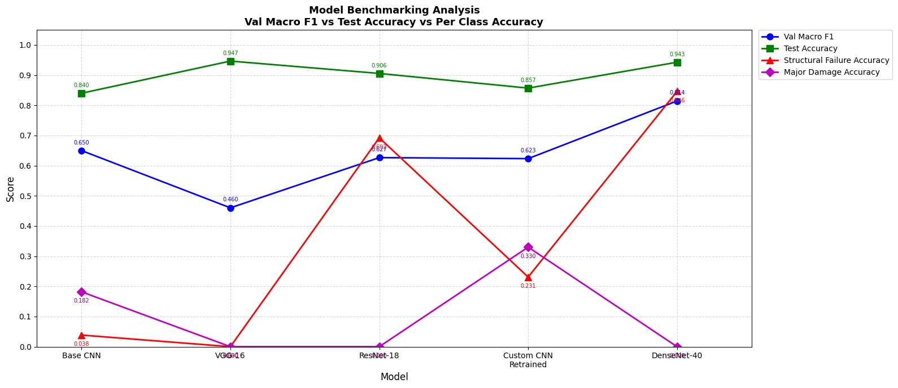
Benchmark Analysis
Model | Test_Acc | Val_Macro_F1 | MD Detected | SF Detected
Custom CNN | 85.70% | 0.7367 | 32% | 23.08%
VGG-16 | 94.66% | 0.4602 | 0.00% | 0.00%
ResNet-18 | 90.56% | 0.6266 | 0.00% | 69.23%
Incepton-V1 | 64.73% | 0.59 | 0.00% | 92.31%
DenseNet-40 | 94.28% | 0.8143 | 0.00% | 84.62%

Slide 15
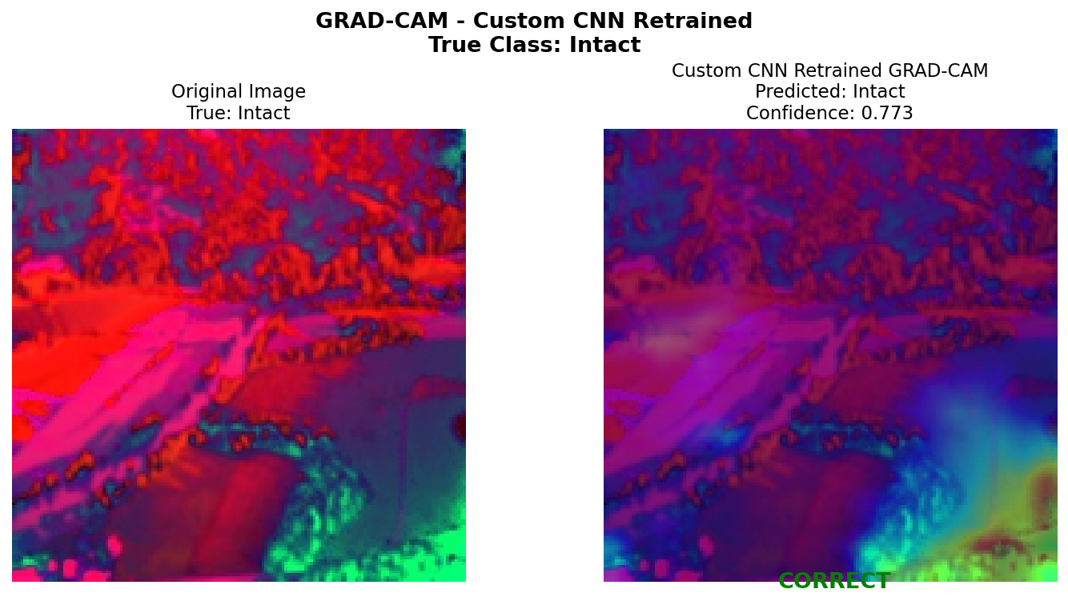
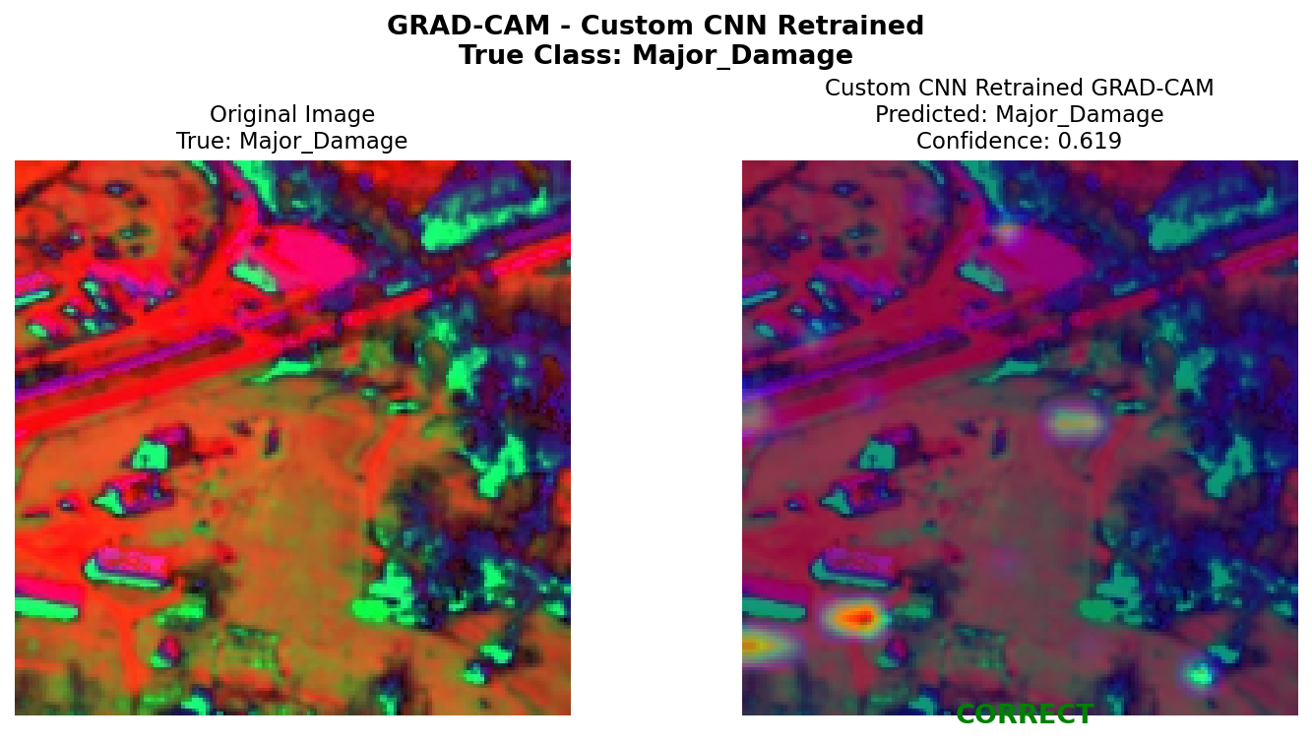
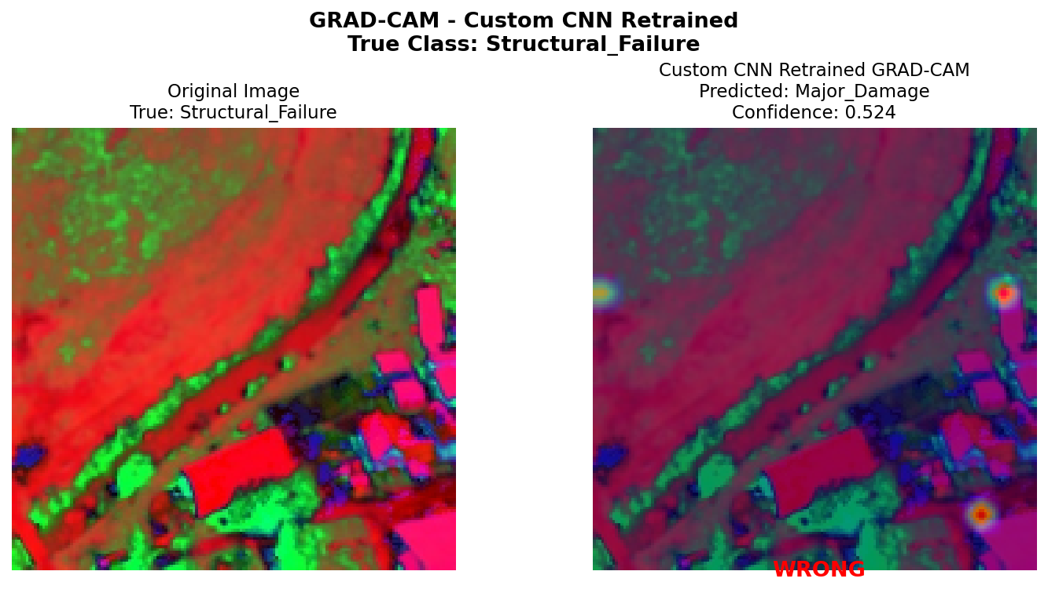
Grad-CAM Visualizations
Gradient-Weighted Class Activation Mapping, shows exactly what regions of image model focuses on for its prediction
Generated for Base CNN Retrained, Red and Yellow regions show high model attention
Class | Images | Correct | Accuracy
Intact | 15 | 13 | ~87%
Major Damage | 15 | 7 | ~47%
Structural Failure | 15 | 0 | 0%
Total | 45 | 22 | 48.89%

Slide 16
Conclusion
DenseNet-40 achieved best overall Validation Macro F1 of 0.8143, a 133% improvement from the baseline 0.33 value
7 Strategies applied simultaneously to address class imbalance, major damage detection improved from 0% to 32%, structural failure detection reached 84%
Future work: collecting more labelled minority class disaster images, explore vision transformer architectures, combining both DenseNet and Base CNN in real-world deployment

Slide 17
Thank You

